Slide 1


Battery Research Project
Department of Electronics System of Technology
By:
Rashida Villacorta
and
Dr. A.M. Kannan (Advisor and Mentor)
ASU/NASA Space Grant Program

Slide 2
Outline
Definition
History
Application
Battery components
How batteries works?
Battery Statistics
Future battery system
Battery for tomorrow
Conclusion
ASU/NASA Space Grant Program

Slide 3


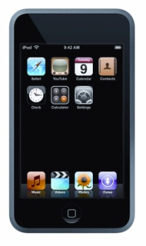
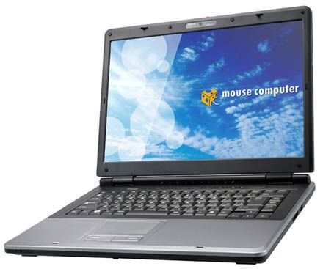
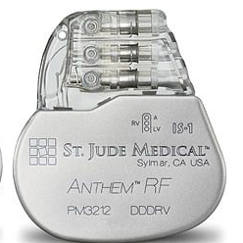
What is battery?
ASU/NASA Space Grant Program

Slide 4
History
1747 -- Principle of the telegraph discovered, but not battery-powered.
Then in 1753 a certain C.M. in Scotland devised a signaling machine that used an
insulated wire for each letter of the alphabet.
1786 -- Luigi Galvani notices the reaction of frog legs to voltage
1800 -- Alessandro Volta publishes details of a battery.
1820 -- The Daniell Cell. A British researcher John Frederich Daniell developed an
arrangement where a copper plate was located at the bottom of a wide-mouthed jar.
1898 to 1908 -- The Edison Battery. Thomas Edison, the most prolific of all
American inventors, developed an alkaline cell with iron as the anode material
(-)and nickel oxide as the cathode material (+).
1950 -- The zinc-mercuric oxide alkaline battery by Ruben.
1964 – Duracell was formed (incorporated)
ASU/NASA Space Grant Program

Slide 5
Common types of commercial batteries
Battery Type | Characteristics | Typical Uses | Advantages
Sealed Lead Acid (SLA) battery | Can hold a charge for up to 3 years | Backup emergency power source | Inexpensive
Nickel-Cadmium (Ni-Cd) battery | Fast, even energy discharge | Appliances, audio and video equipment, toys; most popular batter | Relatively inexpensive; widely available
Nickel-Metal Hydride (Ni-MH) battery | Typical power capacity i1.2 V - 1200 to 1500 mAh; extended life 2300 mAh; 2.5 to 4 hours battery life | Portable computers; cellular phones; same as for Ni-Cd batteries | No memory effect; unused capacity remains usable
Lithium Ion (Li-Ion) battery | Stable and safe; highest energy capacity | Portable computers; cellular phones; same as for Ni-Cd batteries | Twice the charge capacity of Ni-Cd; slow self-discharge
ASU/NASA Space Grant Program

Slide 6
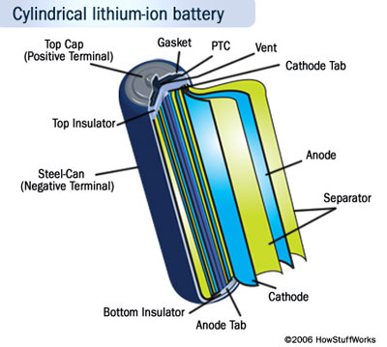
Battery Components
ASU/NASA Space Grant Program

Slide 7
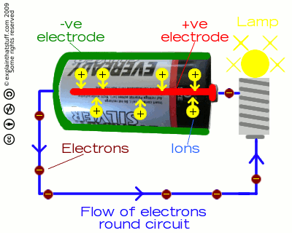
How does it work?
ASU/NASA Space Grant Program

Slide 8
When you connect a wire between negative side to the positive terminal, the electrons will flow from negative to positive terminal.
Connect a load to the battery using a wire and load could be light bulb, a motor, or an electronic circuit like a radio.
A chemical reaction produces the electrons inside the battery and this chemical reaction (the battery's internal resistance)controls how many electrons can flow between the terminals.
Electrons flow from the battery into a wire, and travel from the negative to the positive terminal for the chemical reaction to take place.
ASU/NASA Space Grant Program

Slide 9
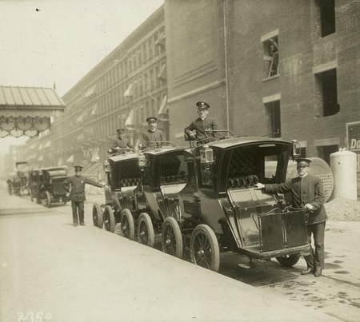
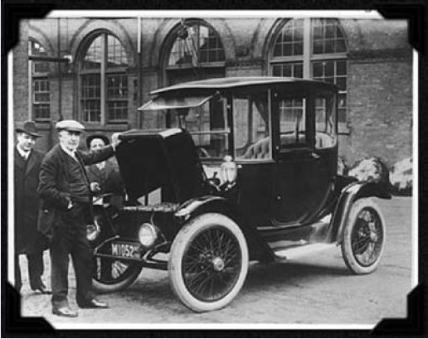
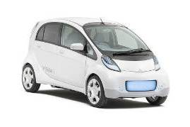
Electricity and batteries
Battery electric vehicles (BEV) – an old story!
Mitsubishi i-Miev
New York taxis, beginning of 1900
Range: 160 km
Top Speed: 130 km/h
Battery: 330 V Lithium ion
Available 2010
Source: ”Plugged in”, WWF
ASU/NASA Space Grant Program

Slide 10
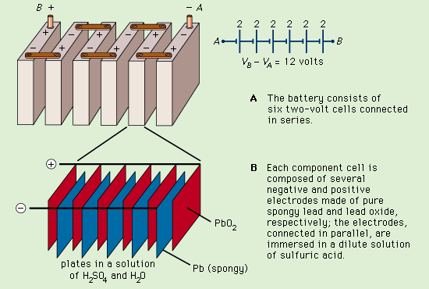
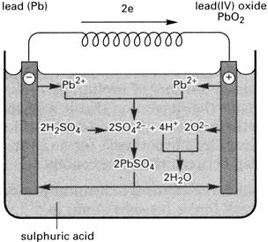
Battery Technologies
First batteries: lead acid
Electrohemical series
Cathode (reduction):
Anode (oxidation):
NB! Batteries with aqueous electrolyte limited to a cell voltage of U < ~ 2 V
ASU/NASA Space Grant Program

Slide 11
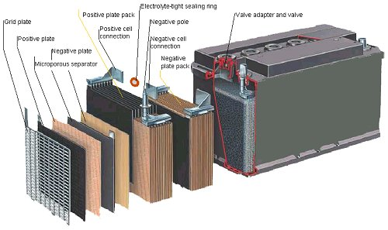
General requirements for application of batteries
  Safety
  Energy density – limited to small vehicles
  Power density
  Charging time - hrs
  Costs
  Resources
  Environmentally friendly production, including recycling
Energy and power densities are coupled!
ASU/NASA Space Grant Program

Slide 12
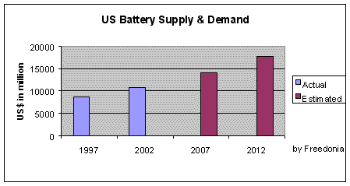
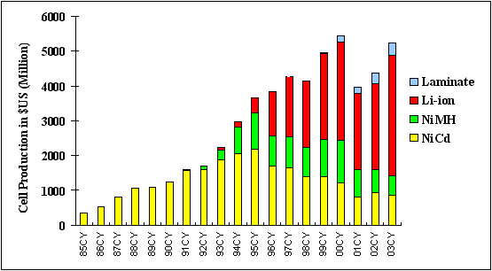
Battery Statistics
Projected demand for batteries in US
Battery world market
ASU/NASA Space Grant Program

Slide 13

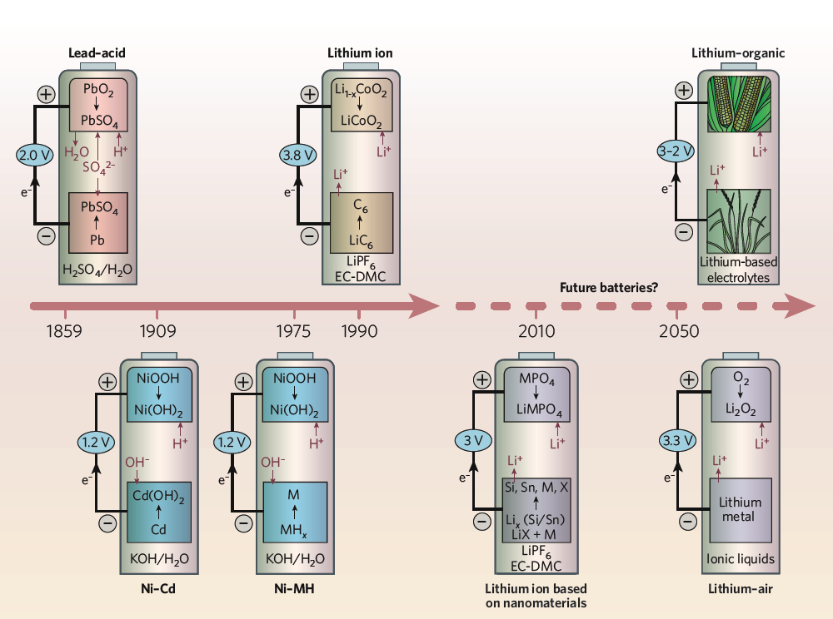
Batteries for tomorrow
8-10 x improvement!
Source: M. Armand and J.M. Trascon, Nature, Vol 451, 2008
ASU/NASA Space Grant Program

Slide 14
Conclusion
Since the first battery was created by Alessandro Volta in 1800, it became our steady travel companion --- it helps call a friend; it expands our workplace beyond four walls; and it supports critical missions for people in need.
There are different types of batteries produced for a wide variety of applications ranging from storing solar power for satellites in space, to powering heart pacemakers fitted inside people's chests, to powering computers, iPods and etc.
The mechanism of the battery; its structure, components of the system , its function and importance that illustrates which battery chemistry is most appropriate for each application.
The future batteries
ASU/NASA Space Grant Program

Slide 15
References:
[1] http://www.topnews.in/files/wireless-pacemakers.jpg
[2] http://www.laredo.edu/distance/mouse-computer-p551-laptop.jpg
[3] http://www.digitivity.com/gifs/future-outlook.jpg
[4] http://www.allaboutbatteries.com/history-of-batteries.html
ASU/NASA Space Grant Program

